Slide 1
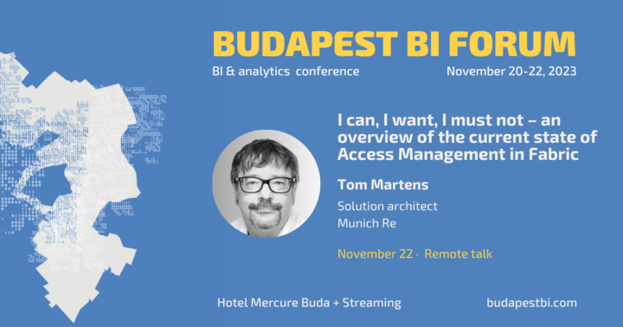
I can, I want, I must not – an overview of the current state of Access Management in Microsoft Fabric
Using Microsoft Fabric
Tom Martens @ Budapest BI Forum 2023
2023-11-22

Slide 2
Inside the box
Who I am
What this session is about!
… and why is this important

Slide 3

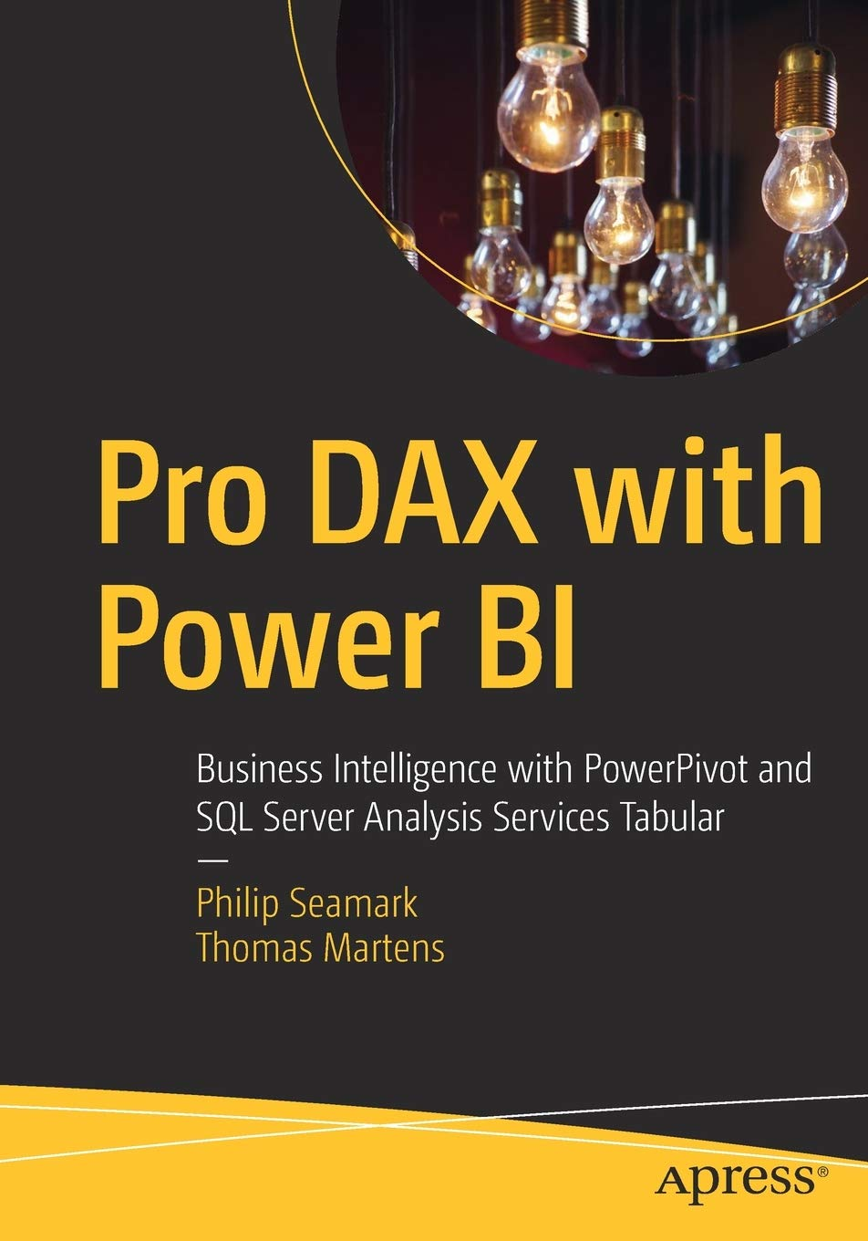

Tom Martens
25+ years of experience designing analytical solutions using the MSFT data platform
Solution Architect @ Munich Re
/tommartens68
@tommartens68

Slide 4

What this is about (and why this is important)

Slide 5
What this session is about!
This session provides an overview of the current state of access management in a Microsoft Fabric-enabled environment. Without any question, Microsoft Fabric will change the analytical landscape of analytical platforms. The possibilities of Microsoft Fabric seem limitless. I assume that fabric will become for analytical platforms what Power BI has become self-service Business Intelligence solutions (to be honest – Power BI is so much more already than a data visualization tool).
Nevertheless, a Fabric workspace is more complex than a Power BI workspace. Of course, it’s still a container able to store artifacts, adding compute capabilities to them. But now we must know that many more personas contribute to the workspace content. More personas are involved in creating a “Fabric Solution” than in the good old Power BI days. This session is not only about safekeeping the artifacts from accidental harm in a workspace container but also about granting access or denying access to the data.

Slide 6
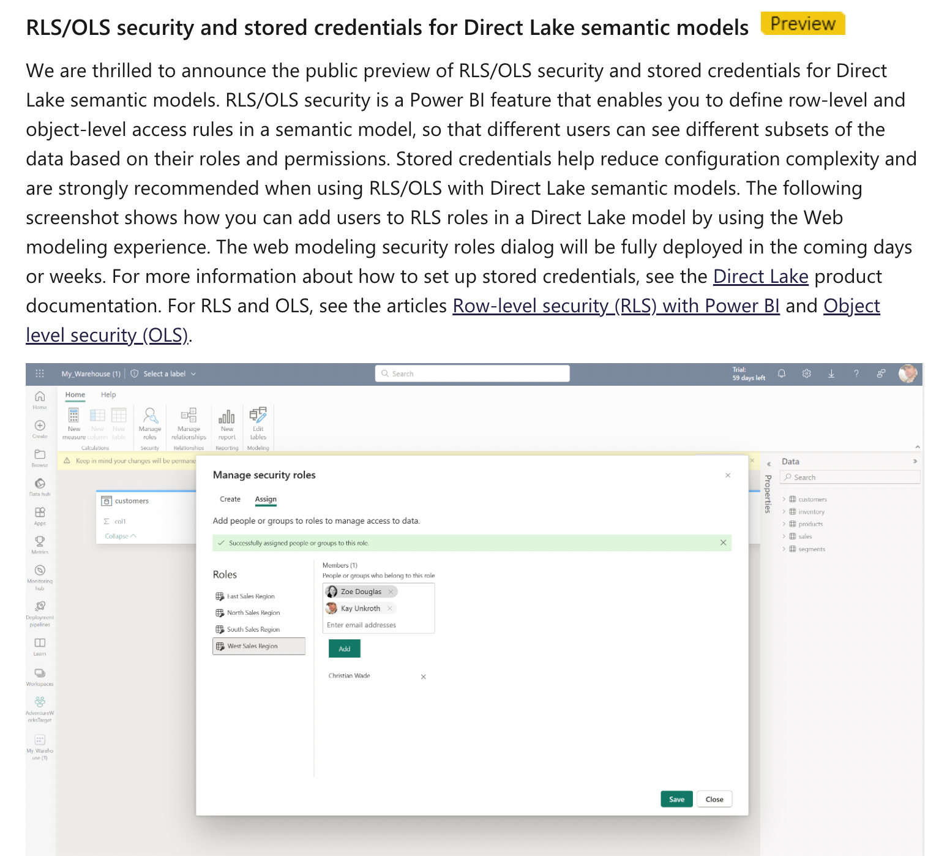
What this session is not about!
This is not about Row Level Security (RLS) on top of semantic models in Direct Lake mode!
This feature is currently rolling out!
https://blog.fabric.microsoft.com/de-de/blog/microsoft-fabric-november-2023-update?ft=All

Slide 7










A little recap, or back to the present (how our current Power BI solution may look like)
Separating the data (the semantic model) from the content (our data visualizations):
Data workspace
Content workspace(s)
Create 1 to n content workspaces
This allows to address different audiences consuming the same data but are not using the same content!
Content creators have at least the contributor role assigned in the content workspace
Content creators are connecting to the Power BI dataset
Content creators are not members of the data workspace
Content creators need Build Permission on the dataset
Row Level Security will be honored if data and content workspaces are separated
Create a data workspace and consider a workspace being an Analysis Services Tabular instance!
Using multiple Power BI files, connected to a Power BI dataset instead of the data sources: thin reports

Slide 8
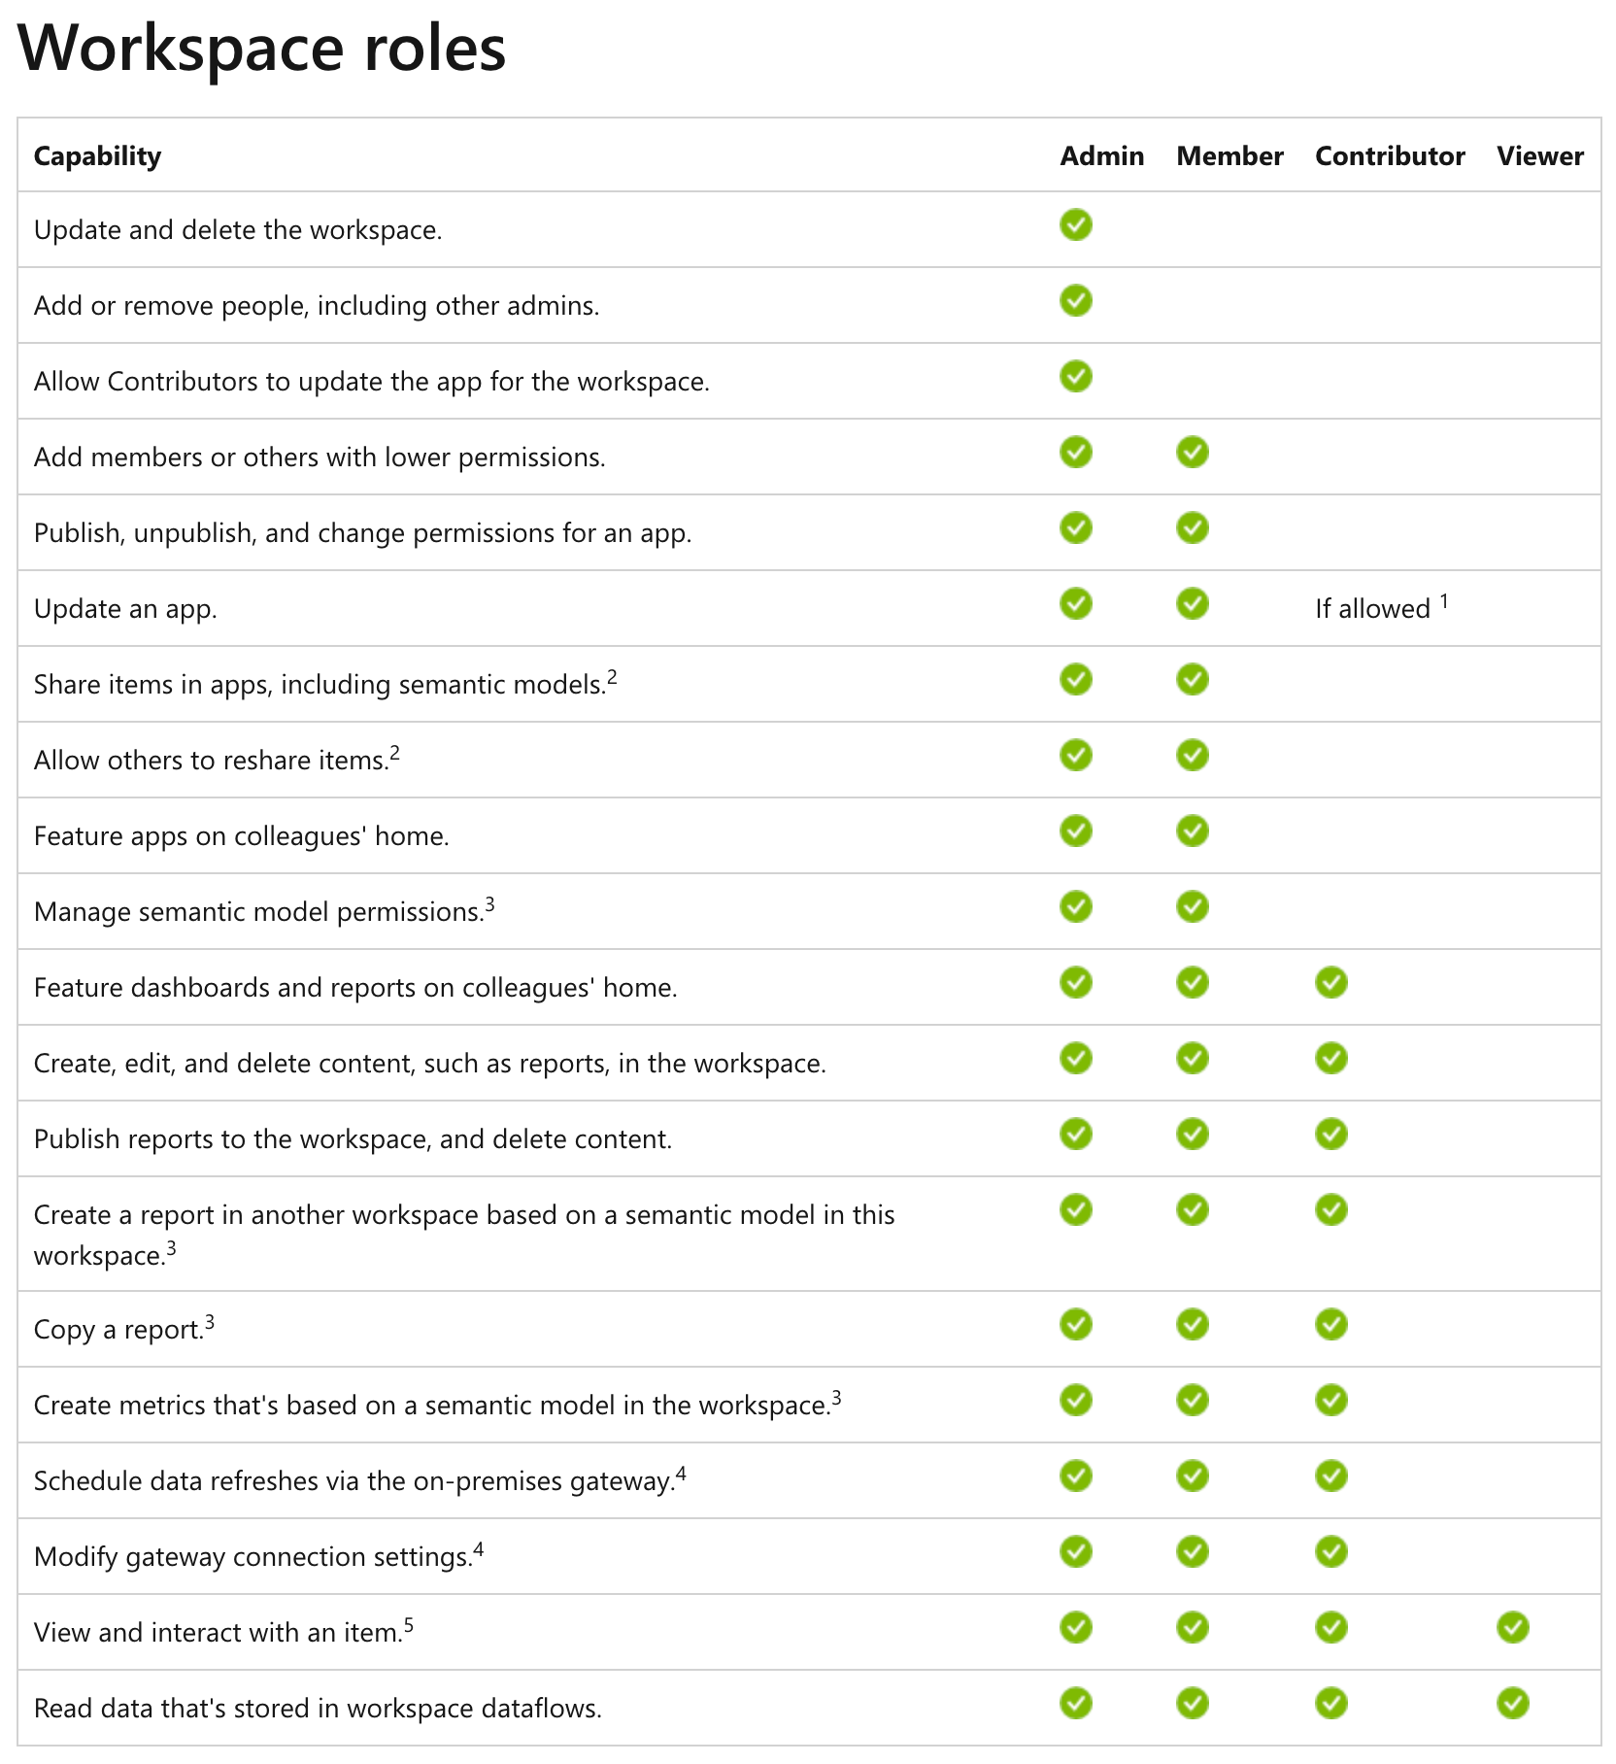
The “simple” Power BI workspace roles
https://learn.microsoft.com/en-us/power-bi/collaborate-share/service-roles-new-workspaces

Slide 9
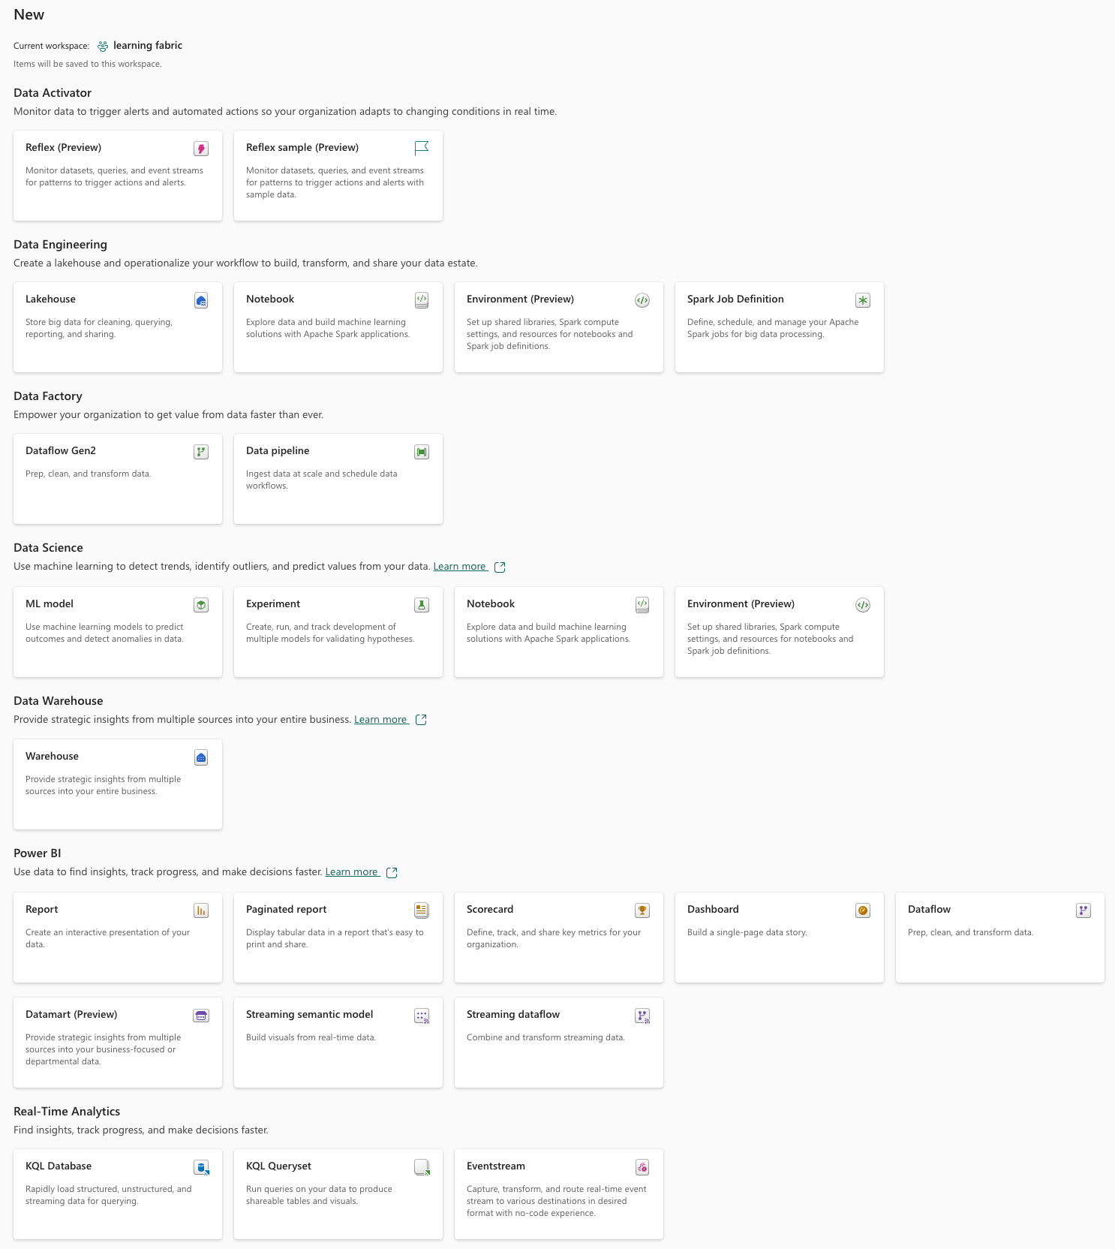
Our Power BI “world” … transformed into a Microsoft Fabric cosmos (basically, this is good)
The amazing things we could create until yesterday …

Slide 10
Our Power BI “world” has transformed into a Microsoft Fabric cosmos (basically, this is good)
The amazing things we can create now!

Slide 11

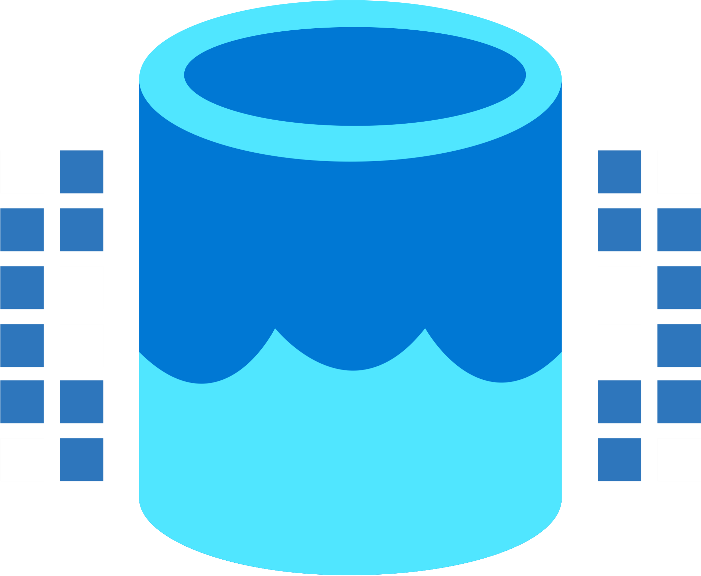


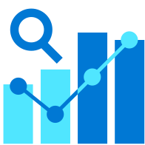

It’s not just the items we are able to create, the team is growing
Data Integration
Data Lake
Spark Engines
Data
Warehouse
Real Time Analytics
Data
Science
Business
Intelligence
Governance
Microsoft Fabric Unified analytics platform
End-to-end analytics data fabric
From the data lake to the business user

Slide 12
It’s not just the items we are able to create, the team is growing
Data Integration
Data Lake
Spark Engines
Data
Warehouse
Real Time Analytics
Data
Science
Business
Intelligence
Governance
Microsoft Fabric Unified analytics platform
End-to-end analytics data fabric
From the data lake to the business user

Slide 13
It’s not just the items we are able to create, the team is growing
Data Integration
Data Lake
Spark Engines
Data
Warehouse
Real Time Analytics
Data
Science
Business
Intelligence
Governance
Microsoft Fabric Unified analytics platform
End-to-end analytics data fabric
From the data lake to the business user

Slide 14
The “simple” Power BI workspace roles (remember from some slides ago)
https://learn.microsoft.com/en-us/power-bi/collaborate-share/service-roles-new-workspaces

Slide 15
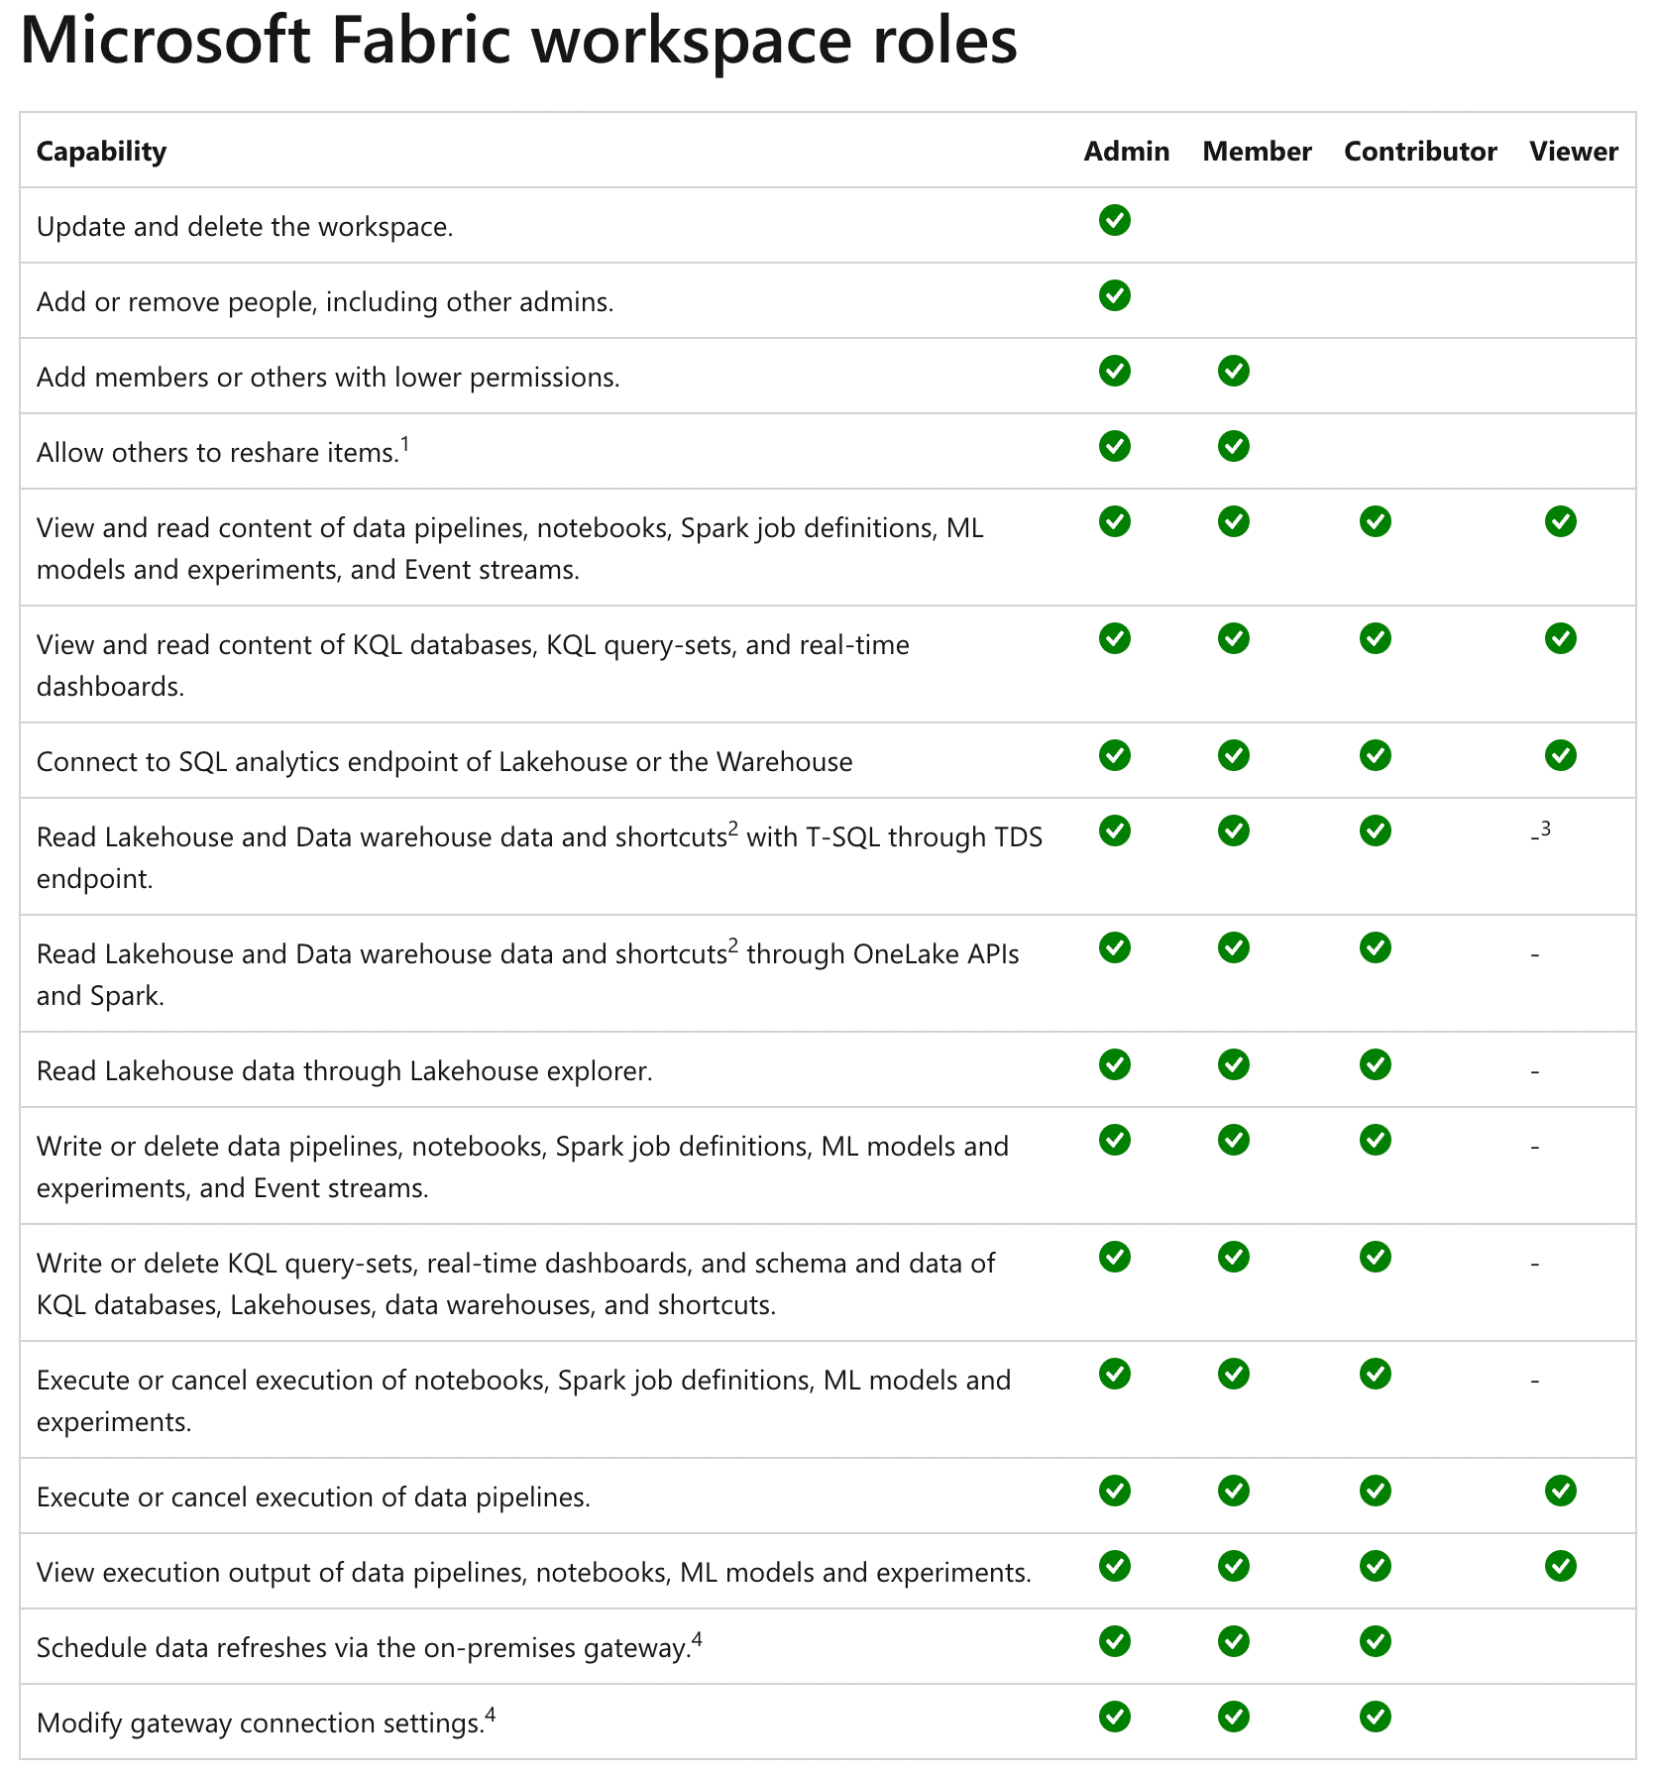
The “simple” Power BI workspace roles are not simple anymore
https://learn.microsoft.com/en-us/fabric/get-started/roles-workspaces

Slide 16

Now some Fabric

Slide 17

My current point of view

Slide 18




My recommendation! (at the current moment)
Use shortcuts to bind them all
Data Integration
Data
Warehouse
Real Time Analytics
Data
Science
Business
Intelligence
the
Storage
called
OneLake
that is based on ADLS Gen2
Delta Table(s)

Slide 19

And now, what?
Get ready for new capabilities!
Understand the core concepts of Microsoft Fabric like
OneLake!
Think about how to organize the awesomeness!

Slide 20
Thank you

